Slide 1


The Evolution of the Comprehensive Academic Program Review - Three Years After Inception
Florida Association of Institutional Research
2011 Annual Conference

Slide 2
Comprehensive Academic
Program Review
Department Academic Effectiveness
St. Petersburg College
P.O. Box 13489,
St. Petersburg, FL 33733
(727) 712-5237
FAX (727) 341-5411
Presenters
Leigh Hopf, Director, Baccalaureate Program Support Services
James Coraggio, Director of Academic Effectiveness and Assessment

Slide 3
SPC Background
SPC, established in 1927, is the oldest
2-year college in Florida
First Community College in Florida to offer 4 year degrees (2002)
9 Campuses throughout the county
2009-10 FTE: 18,707 (LD), 2,055 (UD)
Opening Fall 2010 credited enrollment: 32,429
Annual 2009-10 headcount: 61,592

Slide 4
Purpose
CAPR model was originally presented at FAIR three years ago (2008)
Since that time CAPRs in 23 programs have been completed
This presentation will revisit the CAPR model and discuss its evolution

Slide 5
Compliance Issues with IE
SACS’s Peer Review Research Project revealed that in the area of Institutional Effectiveness (2008)
  62% of institutions in off-site reviews were deemed non-compliant and
  27% of institutions in on-site visits were deemed non-compliant
IE was the second most identified area behind faculty qualifications

Slide 6
SPC Experience with IE
As part of the SACS reaccreditation process, SPC spent a considerable amount of time and effort documenting and detailing their IE processes
The result…SPC had “zero” compliance issues in the area of IE during the off-site reviews

Slide 7
IE Evidence
SACS Suggested Documentation for CR 2.5
  Evidence of linkage of IE to institutional mission
  Institutional plans and budgets that demonstrate linkage of assessment findings to planning at all levels
  Minutes of appropriate (IE related) unit, committee, task force meetings…
  Documentation that relates to IE, such as budget preparation instructions, minutes of budget presentation meetings, annual reports, annual assessment updates, IE reports
  Samples of specific actions taken to improve the IE process and/or results from that process

Slide 8
Performance Improvement
From Compliance to Performance Improvement

Slide 9
IE at SPC
“Closing the Loop”
“Institutional Effectiveness is the integrated, systematic, explicit, and documented processes of measuring performance against the SPC mission for purposes of continuous improvement of academic programs, administrative services, and educational services offered by the college.”

Slide 10
Changes & Improvements
Evaluated individual assessment instruments and current assessment processes
Found new ways to integrate assessment with the educational process
  Focus on fewer, yet meaningful
  improvements (action items)
  Use multiple assessment methods (direct & indirect)
  Involve faculty in process
  Integrate timing of assessments
  (3-year cycle)

Slide 11
Three-year Assessment Cycle
APARs
Academic Program Viability Reviews (APVRs) conducted yearly
CAPRs

Slide 12
Changes and Improvements
Began looking at the ‘Big Picture’
Assessment focus on CHANGE through Quality Improvement
Faculty-driven assessment process; Academic Effectiveness serves in consultant capacity
Improved access and awareness of assessment information

Slide 13
Program Review Process
CAPR process is a summative evaluation that includes two reports with multiple measures such as:
  program-specific performance measures
  profitability measures
  economic data

Slide 14
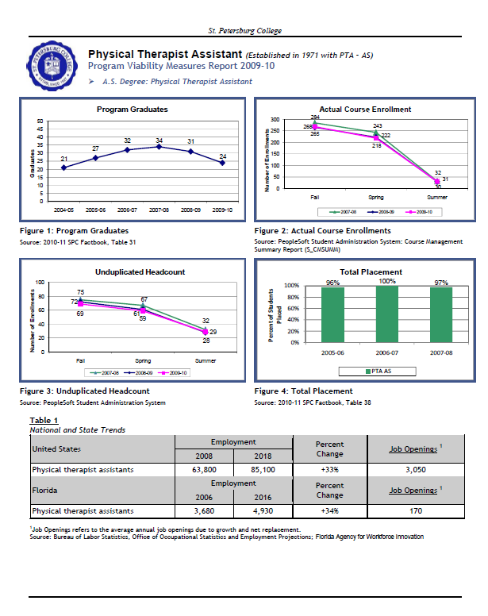
Academic Program Viability Report
Published yearly
Included measures:
  Program Graduates
  Course Enrollment
  Unduplicated Headcount
  Total Placement
  Economic Trend Data

Slide 15
CAPR Objectives
Comprehensive Academic Program Review (CAPR) developed to meet three objectives within the academic assessment process:
  To provide a comprehensive report that summarizes all elements of the program’s viability and productivity from a 360-degree perspective
  To provide comprehensive and relevant program-specific information to key College stakeholders, such as the President’s Cabinet members, in order to make critical decisions regarding the continued sustainability of a program
  To provide program leadership a vehicle to support and document actionable change for the purposes of performance improvement

Slide 16
Previous Program Review Model
Traditionally, program reviews at SPC consisted primarily of a community focus group and a few occupational growth measures
This information was presented to the President’s Cabinet for evaluation
CAPR was designed to be more representative of a program’s quality and, as such, contains measures involving a number of stakeholder perspectives.

Slide 17
Elements of the CAPR
Specific CAPR measures include the
  program description with recent program accreditation information
  program performance measures including enrollment, productivity, grade distributions, and fulltime/adjunct faculty ratios
  program profitability measures
  academic outcomes from recent end-of-program assessments
  stakeholder perceptions including student surveys of instruction results, advisory committee minutes, and employer and recent alumni survey results
  occupation trends and information
  state graduate outcomes information
  the program director’s perspective of program issues, trends, and recent success

Slide 18
Measures CAPR
In order to ensure that the information presented in the CAPR is used appropriately, each measure includes:
  a standardized definition of the performance measure
  a reference to the source information used in the calculation

Slide 19
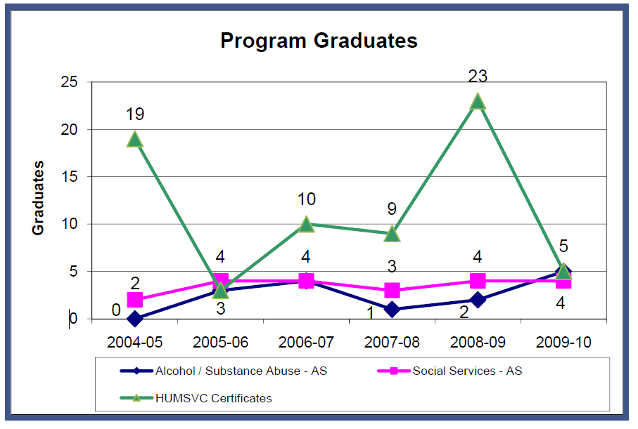
Program Performance Example
Program Graduates
Figure 5: Program Graduates
Source: 2009-10 SPC Factbook, Table 31

Slide 20
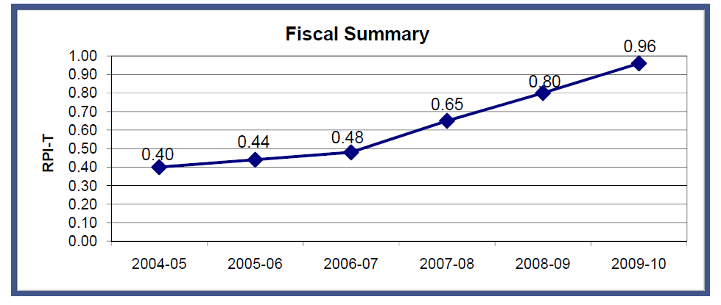
Program Profitability Example
Relative Profitability Index (RPI) is calculated by dividing a program’s income by the sum of its personnel costs and current expenses.
Figure 9: Fiscal Summary
Source: PeopleSoft Financial Production database, report ID: ORGBUDSI

Slide 21
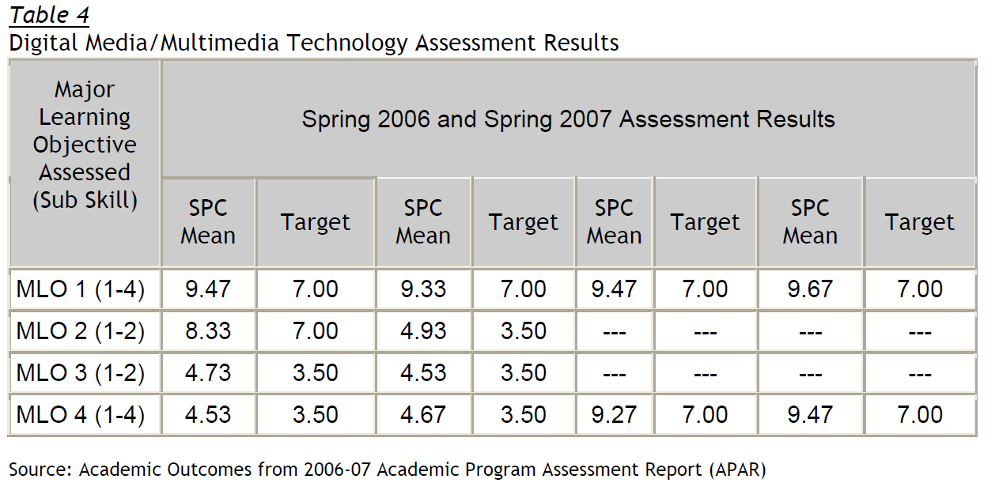
Academic Outcomes Example
Digital Media/Multimedia Technology program was evaluated through an Academic Program Assessment Report (APAR) in 2006-07. Each of the program’s four major learning outcomes (MLOs) was evaluated.

Slide 22
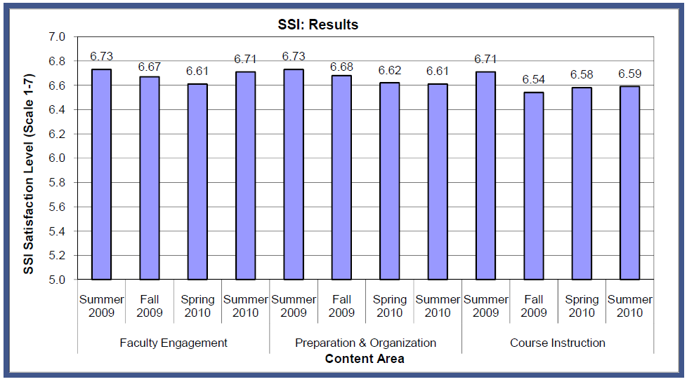
Stakeholder Perceptions Example
Purpose of the SSI survey is to acquire information on student perception of the quality of courses, faculty, and instruction, and to provide feedback information for improvement.
Figure 10: SSI Lecture Courses
Source: Student Survey of Instruction Administration Site

Slide 23
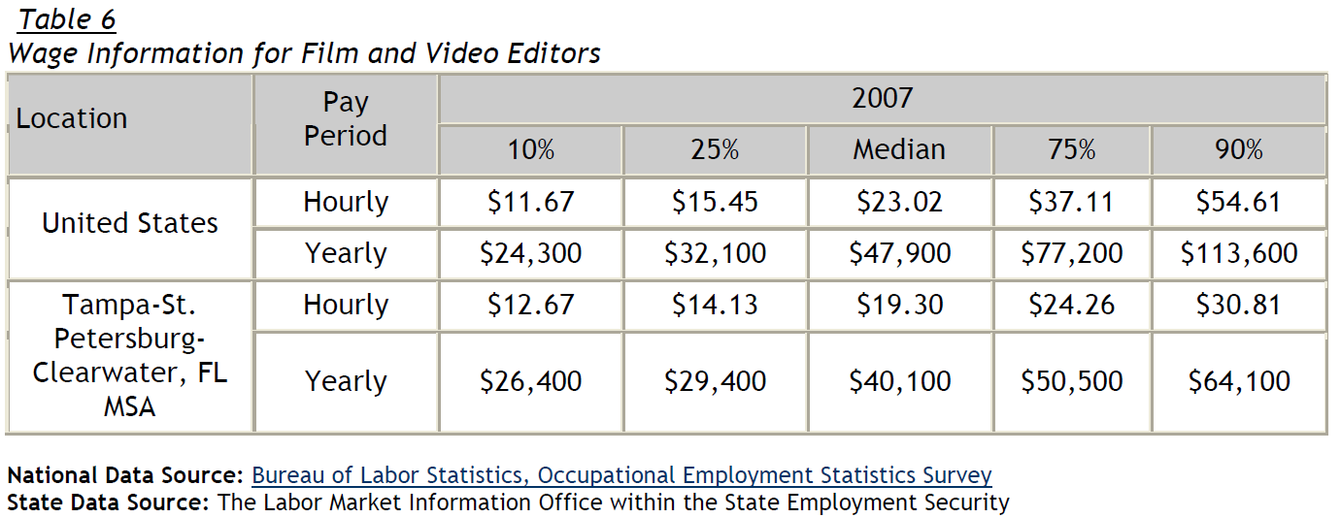
Occupation Profile Example
The distribution of 2007 wage information is divided by percentiles for hourly and yearly wages.

Slide 24
Use of Results
To encourage the use of results, the program director and provost are required to provide an action plan for improving the performance of the program
Follow-up report on these results is required the following year
CAPR process also includes a review of the CAPR documentation by the advisory committee and the President’s Cabinet

Slide 25
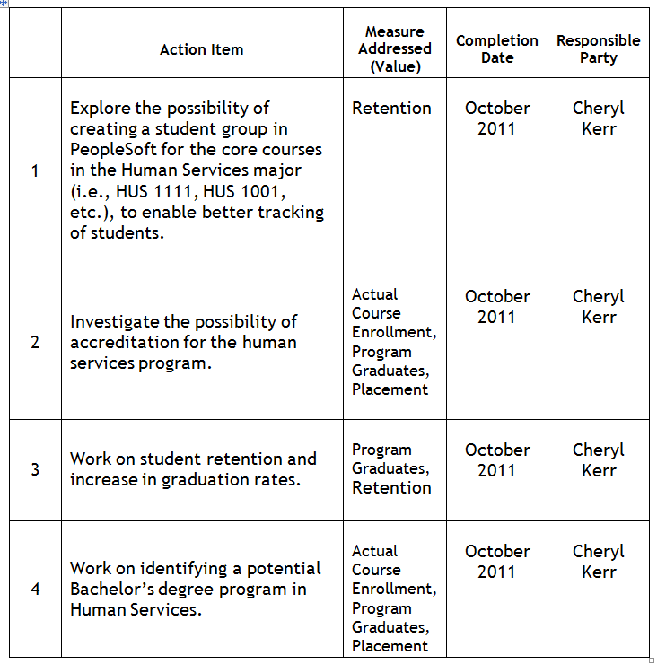
Action Plan Example
Also includes sections for special resources needed and area(s) of concern/ improvement.

Slide 26
Stakeholder Perceptions
CAPR has been well received by stakeholders (program directors, provost, and members of the President’s Cabinet)
  “…provides a more representative picture of the overall quality and sustainability of an individual academic program.” - SVP, Baccalaureate Programs and University Partnerships
  “…greatly enhanced SPC’s capacity to evaluate its lower division academic programs and to encourage the use of assessment results to improve College programs.” – VP, Information Systems, Business Services, Budgets, Planning

Slide 27
Ed Outcomes Site
To provide a medium for completing the educational assessment reports as well as establishing a repository for program specific information, SPC developed an Educational Assessment Web site (https://it.spcollege.edu/edoutcomes/)
College administration and instructional staff are provided access to “completed” assessment reports including the CAPR
Online access further encourages the use of assessment data as well as highlighting “best practices” across the college

Slide 28
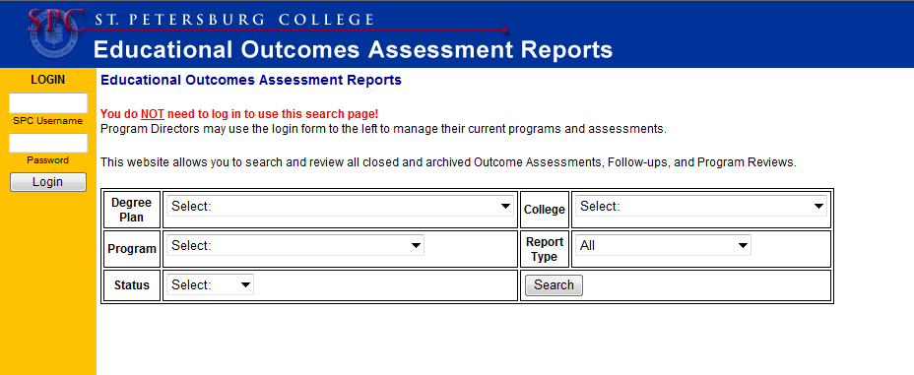
Ed Outcomes Site – College Access

Slide 29
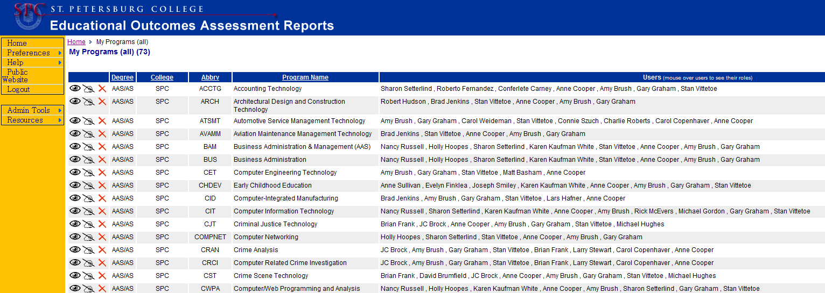
Ed Outcomes Site – PD Access

Slide 30
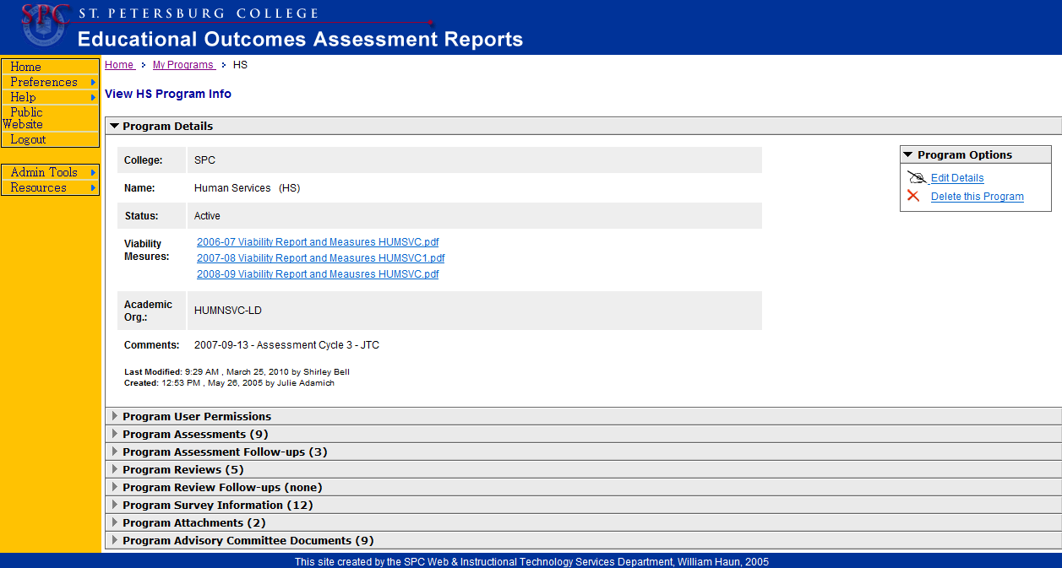
Ed Outcomes Site – PD Access

Slide 31
Ed Outcomes Site – CAPR
Program Review is just one of the educational materials included in the Ed Outcomes site
CAPRs are uploaded into the site as a complete document (PDF)

Slide 32
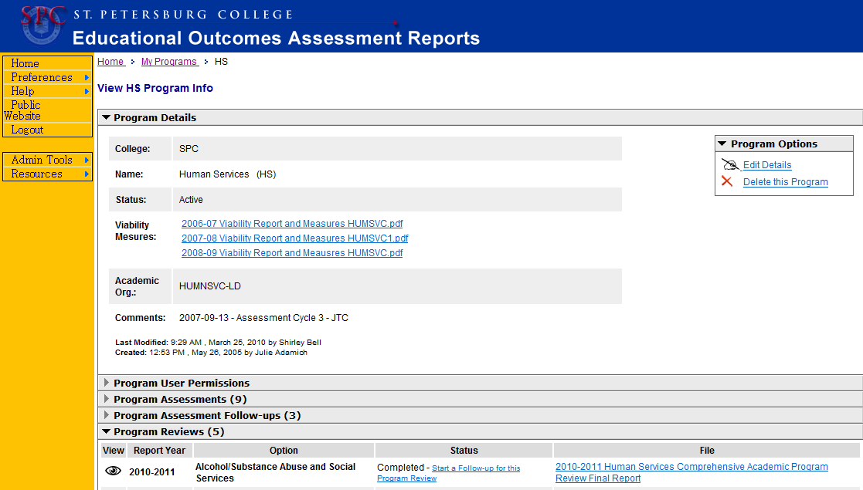
Ed Outcomes Site - CAPR

Slide 33
Additions to CAPR
Summary section was replaced with the Program Director’s Perspective: Issues, Trends, and Recent Success.
Section containing the names of the major employers in the program was added

Slide 34
Additions to CAPR
Unduplicated Headcount Enrollment measure was added
FETPIP Placement Rates were also added

Slide 35
Lessons Learned
Process requires adequate staffing and resources
Process should not be a ‘gotcha,’ it should be improvement focused and collegial in nature
Requires support of senior leadership
Need access to data and information

Slide 36
Lessons Learned
Involve faculty at start
Need models for dissemination of reports as well as encouraging transparency of information
Use process to share best practices across disciplines
Be open to policy changes as a result of the gathered information

Slide 37
Future Direction
New Accreditation and Baccalaureate Assessment Coordinator position has been created
CAPR and APVR program reviews for the baccalaureate programs will be one of the first responsibilities
APVR for the Baccalaureate programs will be conducted in 2011

Slide 38
Future Direction
Our ultimate goal is to provide stakeholders ‘timely’, ‘relevant’, ‘accurate’, and ‘interpretable’ data through:
  Formatted (dashboard) style reports, and
  On-demand customizable reporting, with
  Valid, reliable, and standardized measures.

Slide 39

Questions
Department of Institutional research and Effectiveness
St. Petersburg College
P.O. Box 13489,
St. Petersburg, FL 33733
(727) 341-3059
FAX (727) 341-5411

Slide 40
The Evolution of the Comprehensive Academic Program Review - Three Years After Inception
Florida Association of Institutional Research
2011 Annual Conference

